Slide 1


Business Problem 4 – British Business Bank

Slide 2

Business Problem:
You have been hired by the Bank in UK as a Tableau Developer.
Your first assignment is to deliver a Customer segmentation dashboard with Map view of customers by state and show the distribution of customers by Age and Bank balance. Also create a Donutchart and provide details of percentage of customers by gender.
Show a data distribution based on different jobs
Create an interactive dashboard which will help business to take quick decisions in no time.
Also help business to educate what is the difference between Dashboards and Story in Tableau
What we will learn today
Where to use which type of charts
Parameters
Bins
Variable sized bins
Charts
Donut Chart
Histogram
Tree Map
Story in Tableau
Difference between Story and Dashboard

Slide 3
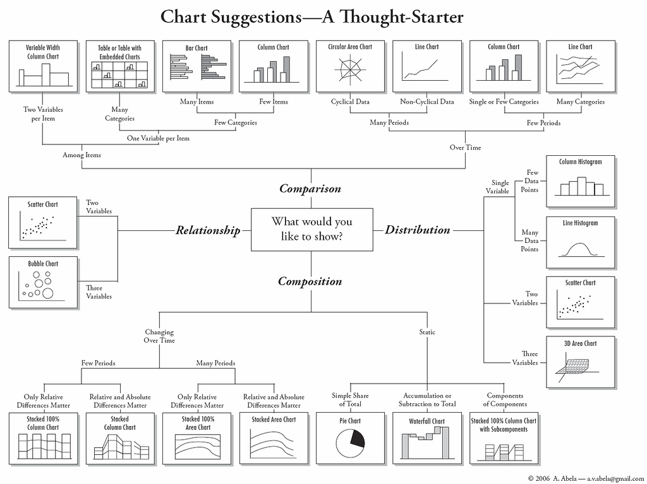

Slide 4
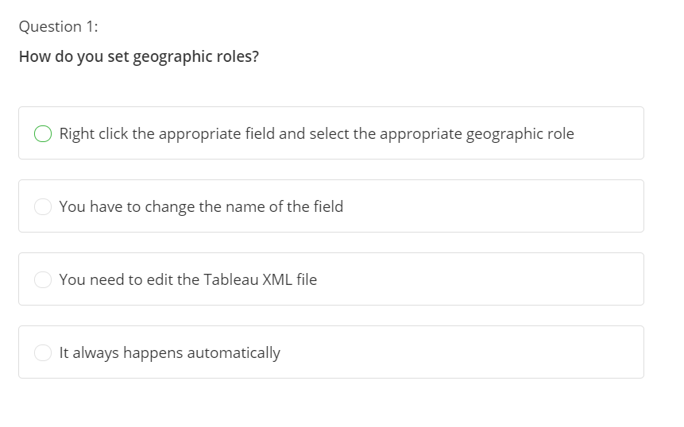

Slide 5
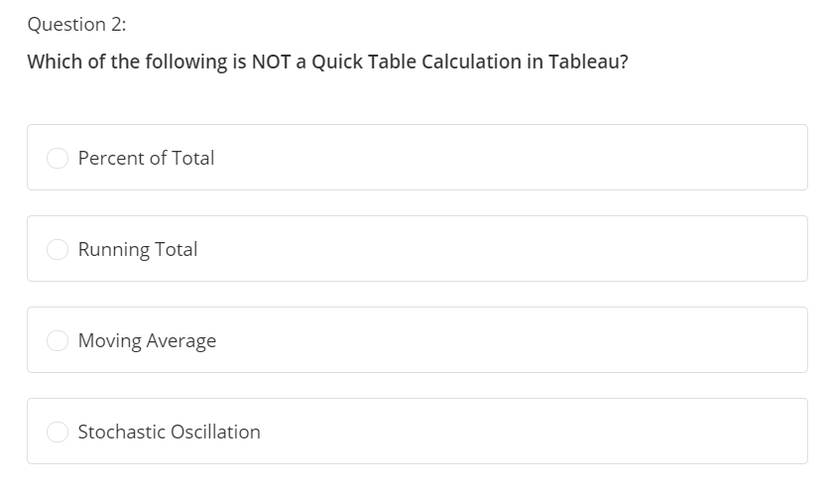

Slide 6
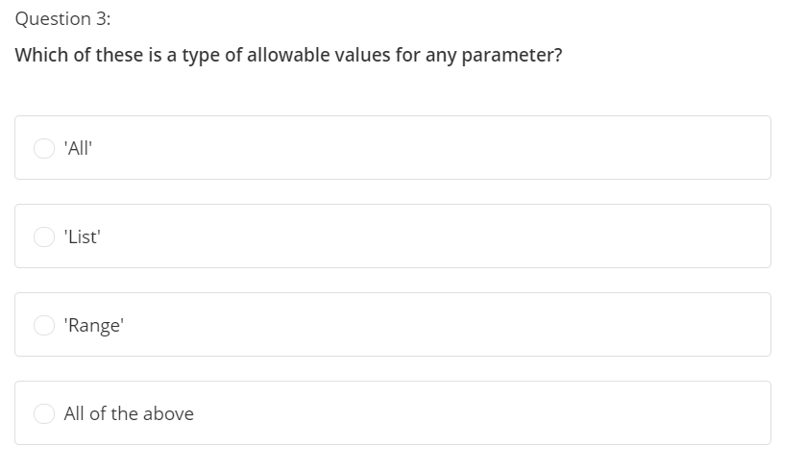

Slide 7
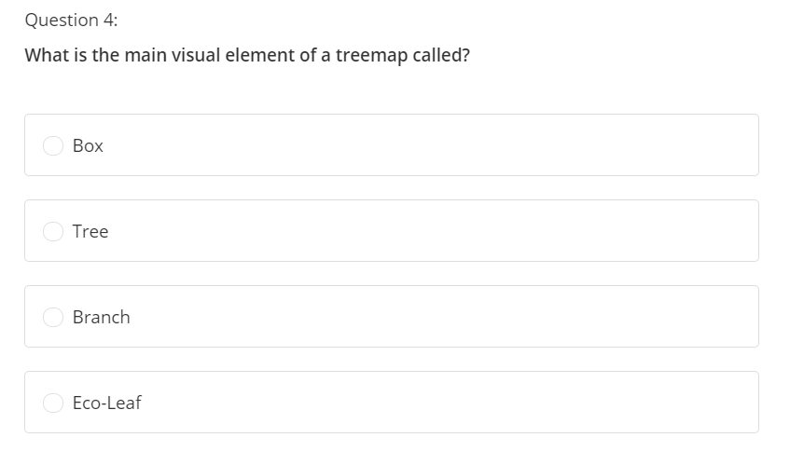

Slide 8
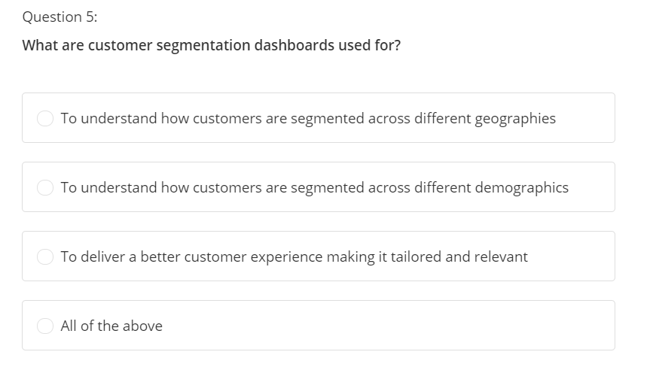

Slide 9
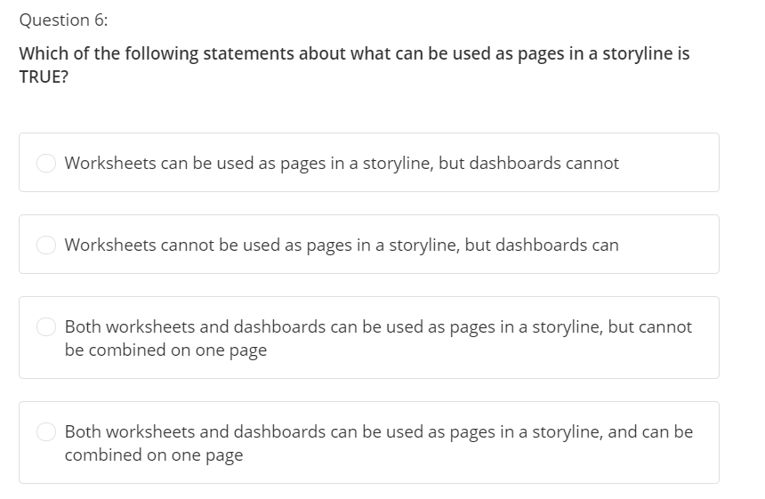

Slide 10
